Slide 1
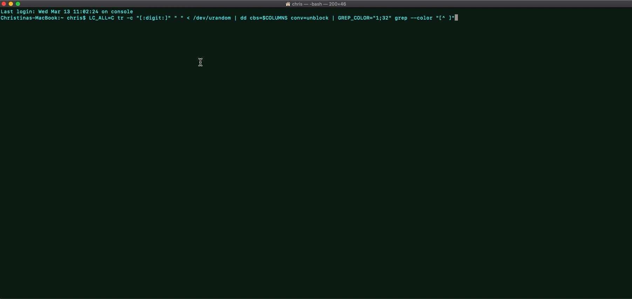
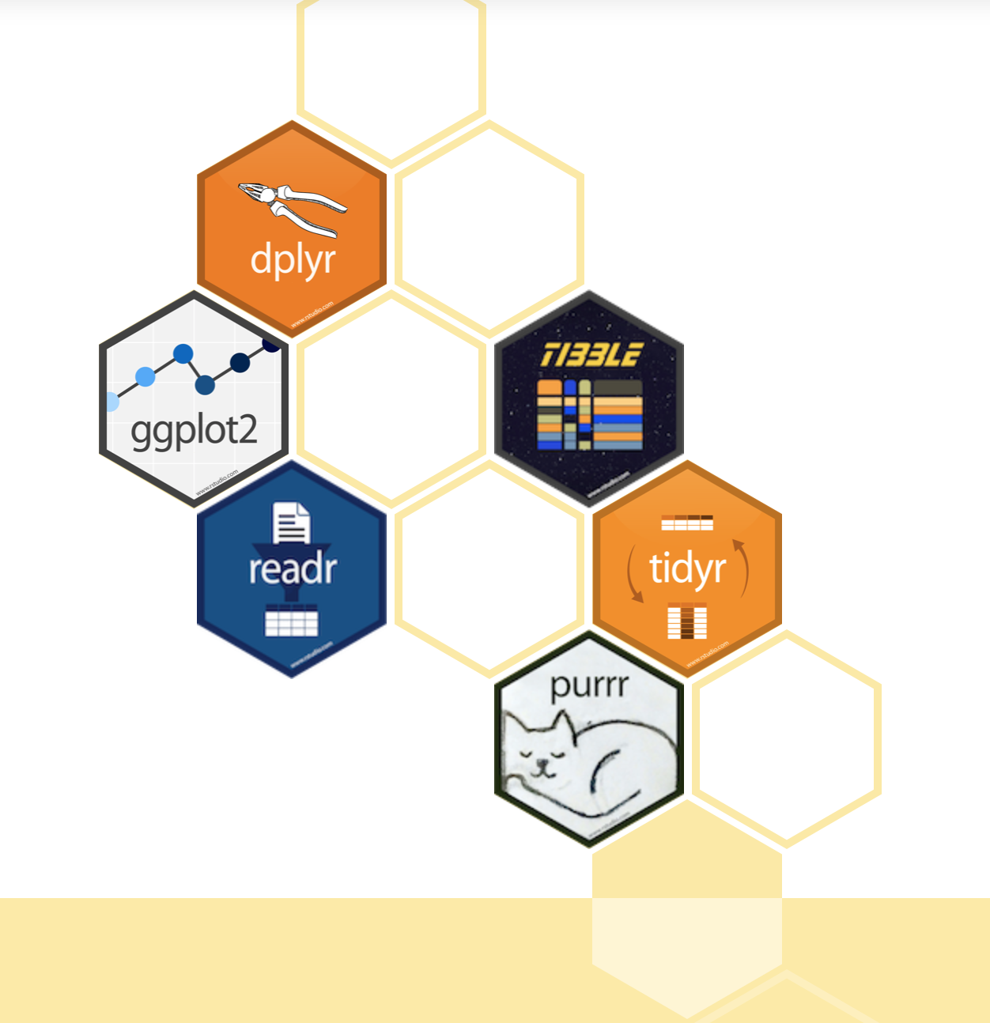
Tidyverse
A.K.A How to Kon-Mari your data
Christina Van Heer
christinavanheer@gmail.com

Slide 2

Disclaimers
I am not an expert in coding - I don't have a background in computer science or engineering where coding is routine
The advantage (?) of this is that I'm pretty good at knowing what it's like to be like this guy ->
I learnt to use the tidyverse a few months ago (actual lol) so who knows if I know anything really…..

Slide 3

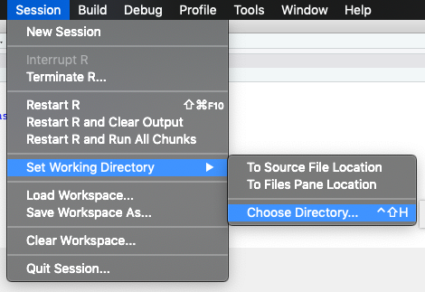
Make sure your R is looking in the right place!
Open the R Markdown document you are working with
2. Set your working directory (the place where R studio looks for files)
FAQs
What is a working directory?
It is the place R looks when it is loading stuff
So if you have opened an R Markdown file and you want to load some data, R studio needs to be looking in this directory
- How do I set my working directory?
- Session > Set Working Directory > Choose Directory
Make sure you are in the right FOLDER (you don’t choose a file) and click ok if you are in the right place
OR
- Session > Set Working Directory > To Source File Location
Will do this to the same place where your R markdown file is….but the data needs to be in the SAME folder)

Slide 4

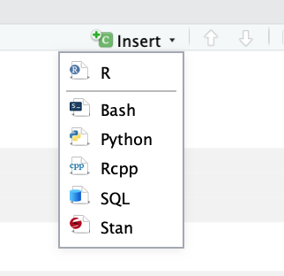
Using R markdown
We want to have a record of what we do
A markdown document can do this
A markdown document consists of two main areas
Code areas (grey bits)
Comment / writing areas (white bits)
R studio reads this section as “oh hey this is code!” This is because
```{r} is at the start
and
``` is at the end
```{r}
```

Slide 5
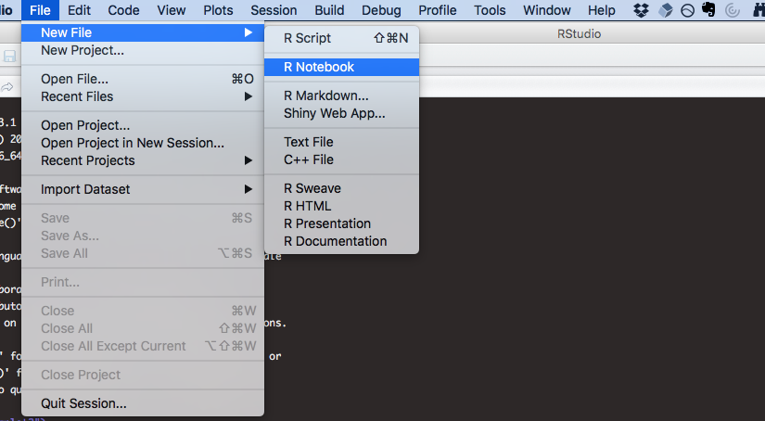
Opening a notebook file

Slide 6
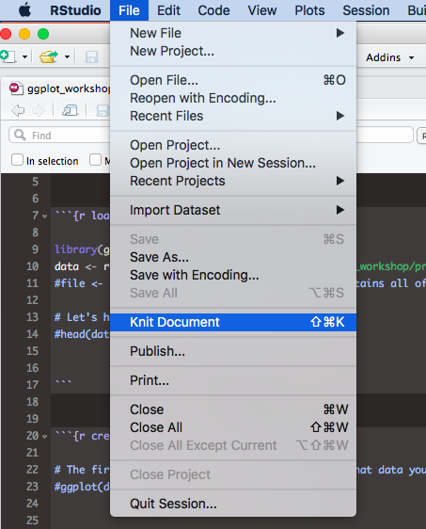
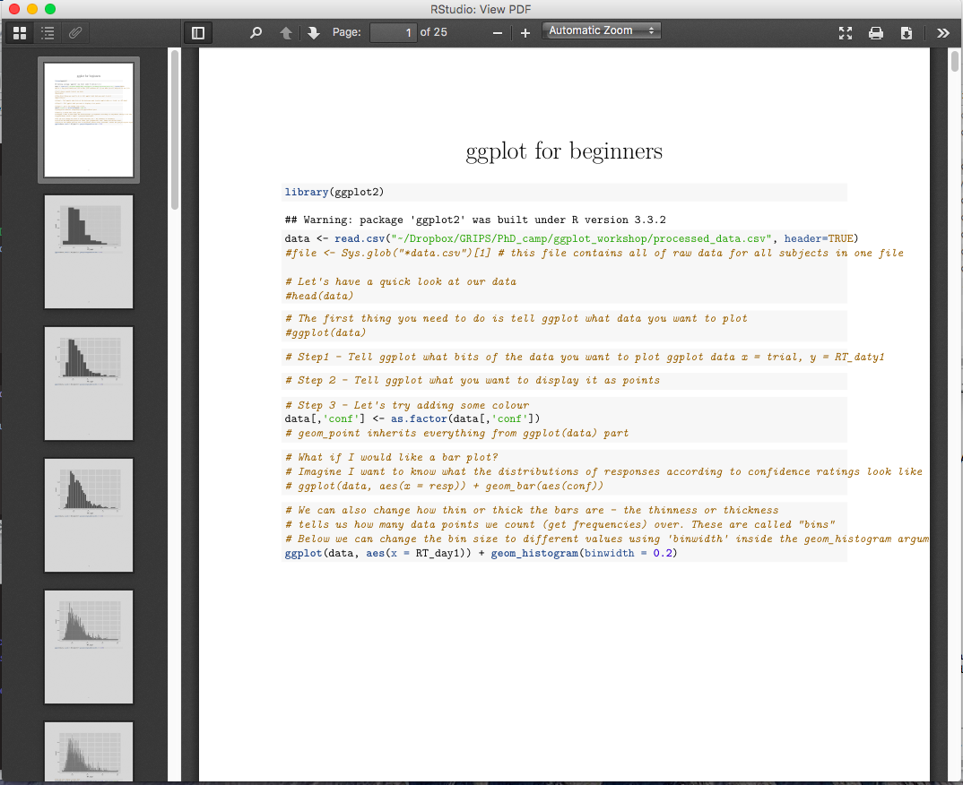
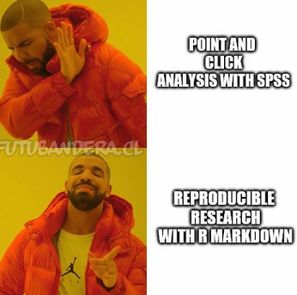
Knit it good

Slide 7
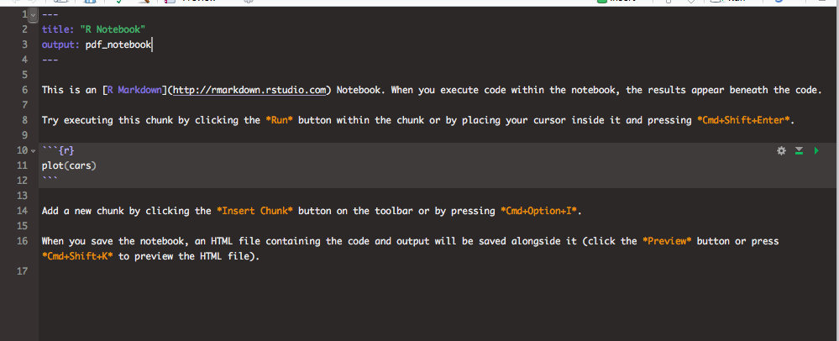
We can change the type of output

Slide 8
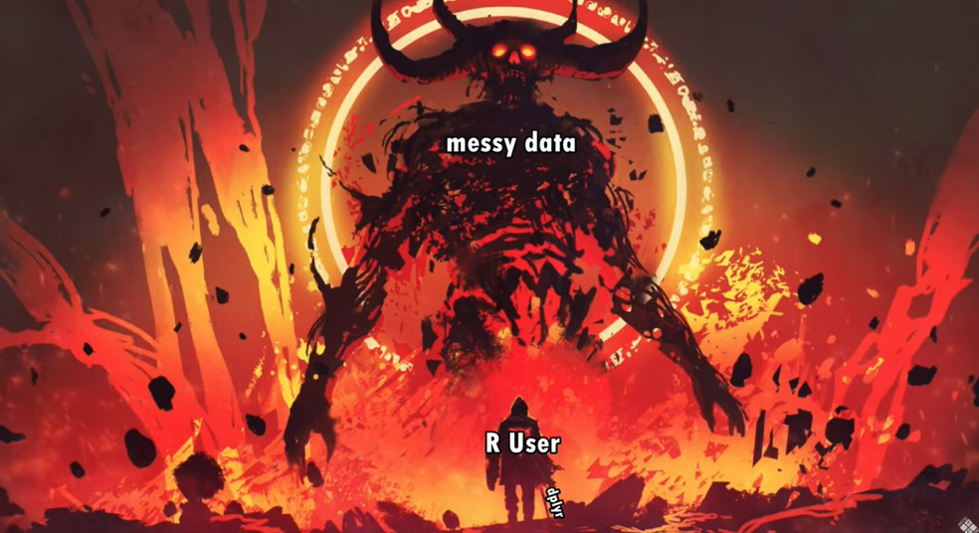
What is the tidyverse?
In R, we use functions to perform operations on data
You can think of a function as a box that takes something in, performs some operation on it (e.g. calculate the mean) and then spits something out (e.g. the mean)
e.g try - mean(c(10, 30, 25, 16) in your R console
Manipulating datasets in R can be difficult because the way different functions work
The idea behind tidyverse is that you have a set of packages which contain useful functions to help you manipulate data easily
The packages work well with each other and allow you to shift the data between them easily

Slide 9

Learning the ways of the Tidyverse (force)

Slide 10
Tibbles vs data frames

Slide 11
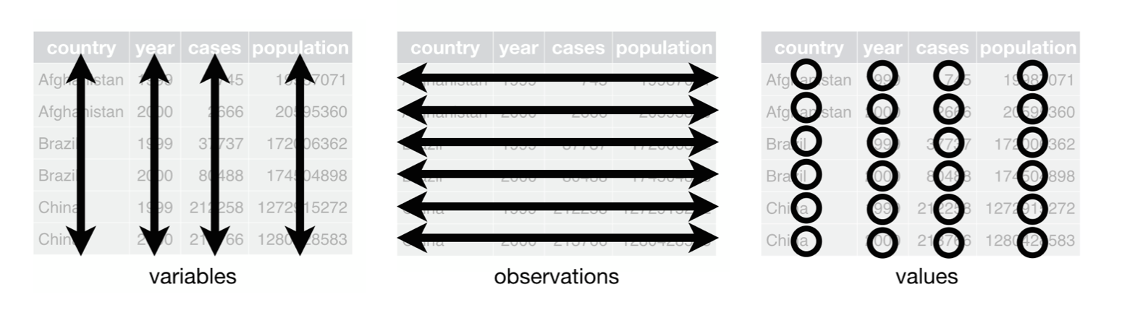
Learning the ways of the Tidyverse (force)
Each variable must have its own column.
Each observation must have its own row.
Each value must have its own cell.

Slide 12
Learning the ways of the Tidyverse (force) - pipes
%>% = a pipe
le_data %>%
do_something %>%
do_something_else_plz %>%
also_this_thx

Slide 13
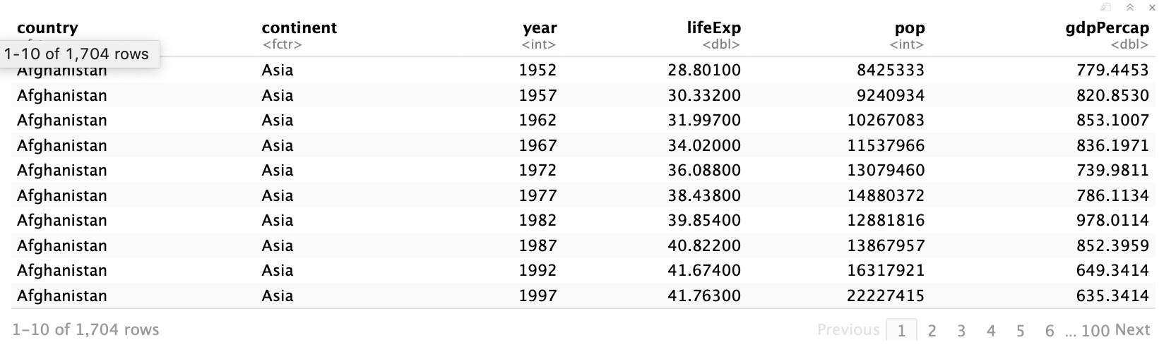
Learning the ways of the Tidyverse (force) - group_by
group_by selects rows out by a particular group
Useful if you want to do something by subject no. e.g. calculate mean of some measure
We usually use group_by and then pipe the data onto another function with %>%
gapminder %>%
group_by(country, year)

Slide 14
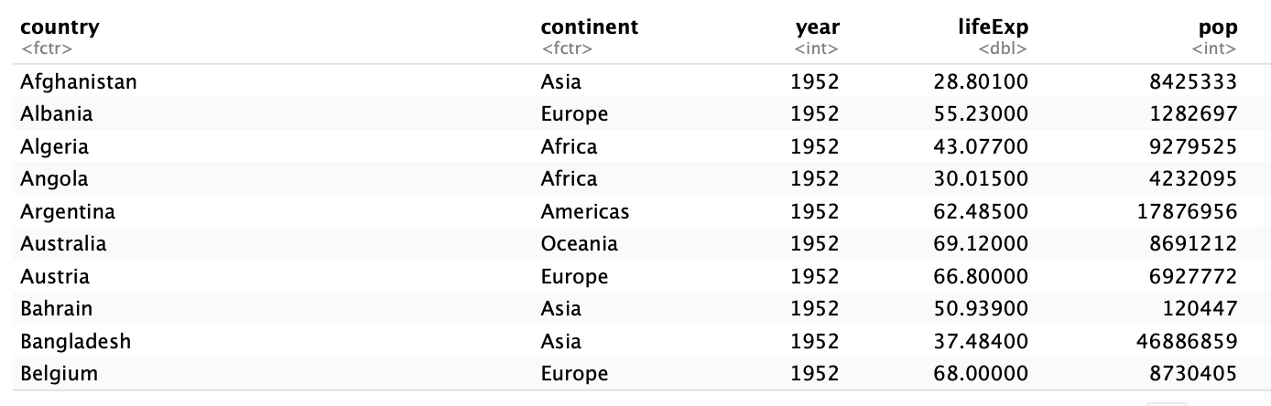
Learning the ways of the Tidyverse (force) - arrange
arrange sorts data out by a particular group
Useful if you want to view your data in a particular way
Putting a ‘-‘ sign = descending
gapminder %>%
arrange(-year)
gapminder %>%
arrange(year)
gapminder %>%
arrange(desc(pop))

Slide 15
Learning the ways of the Tidyverse (force) - filter
filter selects data which fulfils a particular rule
Useful if you want to do something to a selection of the data
We usually use filter and then pipe the data onto another function with %>%
gapminder %>%
filter(continent == “Europe”)
gapminder %>%
filter(year > 1975)
gapminder %>%
filter(between(year, 1950, 1975))

Slide 16
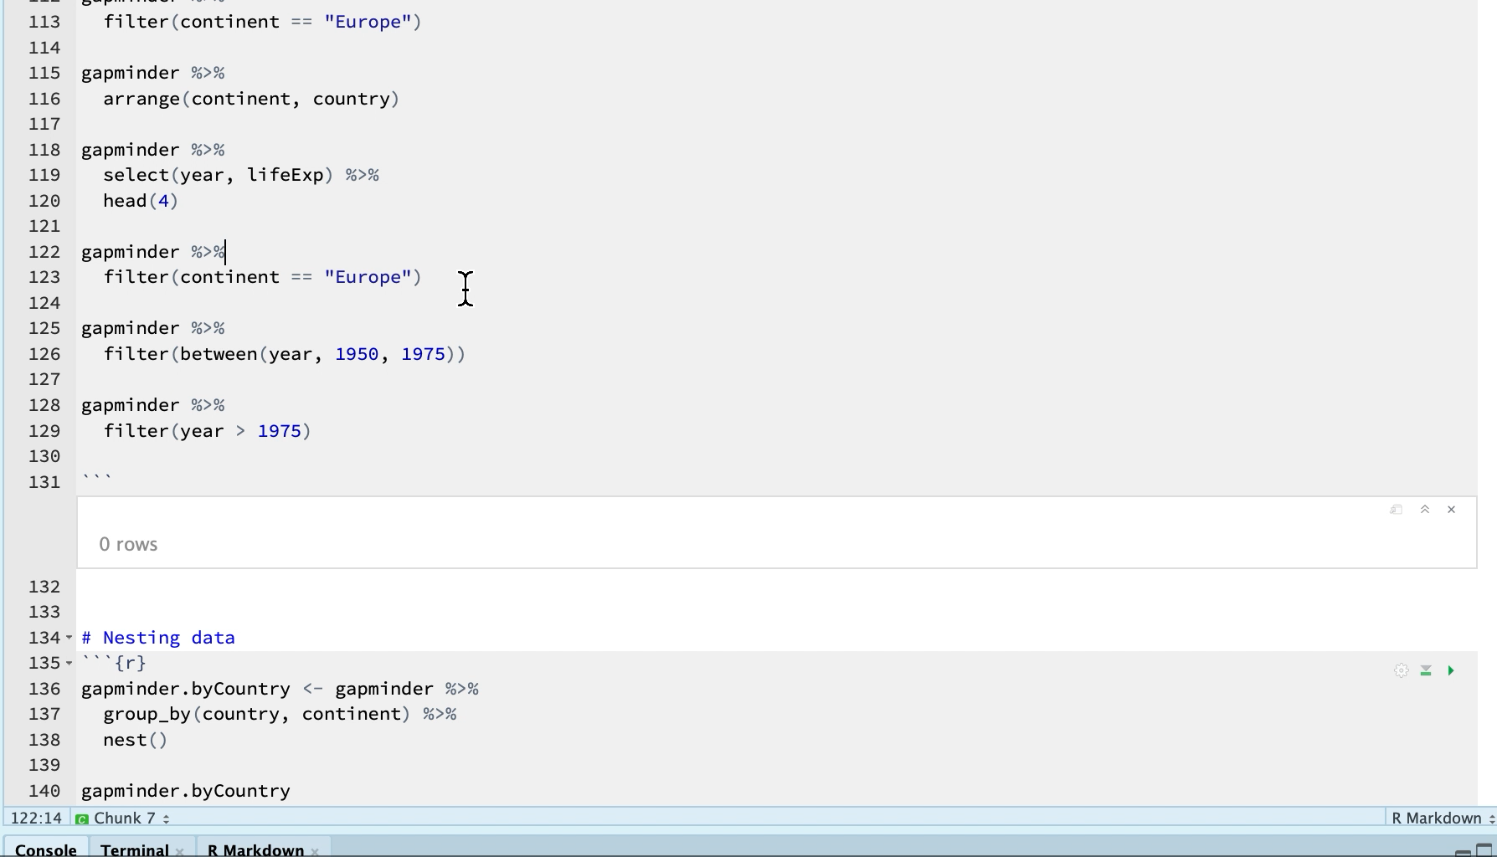
Learning the ways of the Tidyverse (force) - filter - video
gapminder %>%
filter(continent == “Europe”)
gapminder %>%
filter(year > 1975)
gapminder %>%
filter(between(year, 1950, 1975))

Slide 17
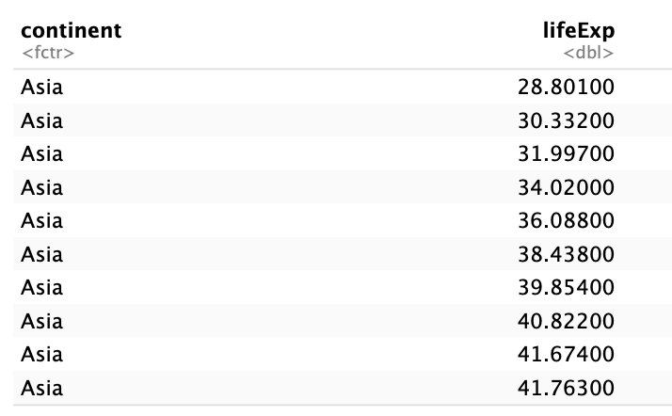
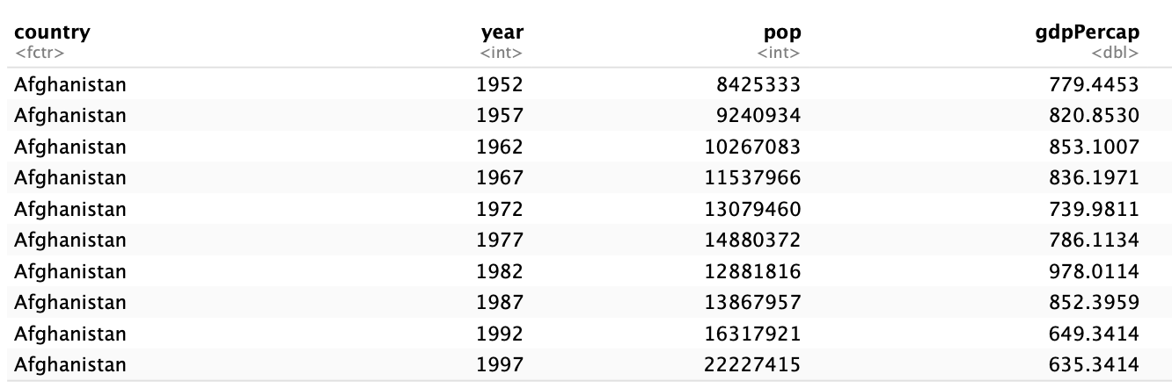
Learning the ways of the Tidyverse (force) - select
Select allows you to select or get rid of specific columns of a tibble
Useful if you want to get rid of some columns
We usually use select and then pipe the data onto another function with %>%
gapminder %>%
select(continent, lifeExp)
gapminder %>%
select(-continent, -lifeExp)

Slide 18
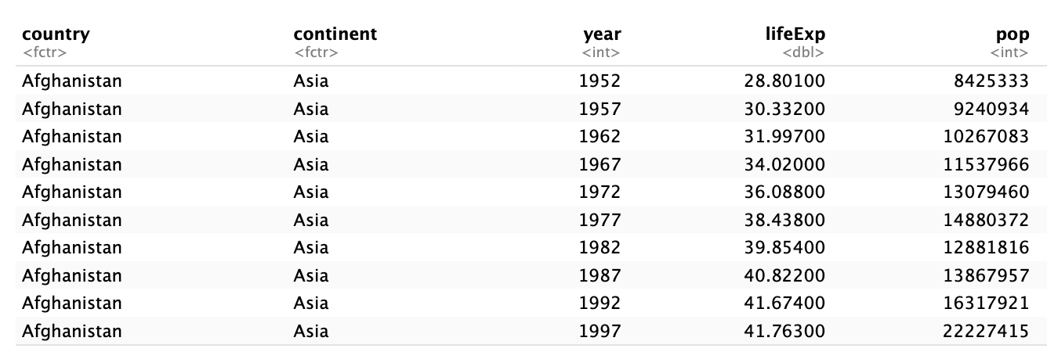

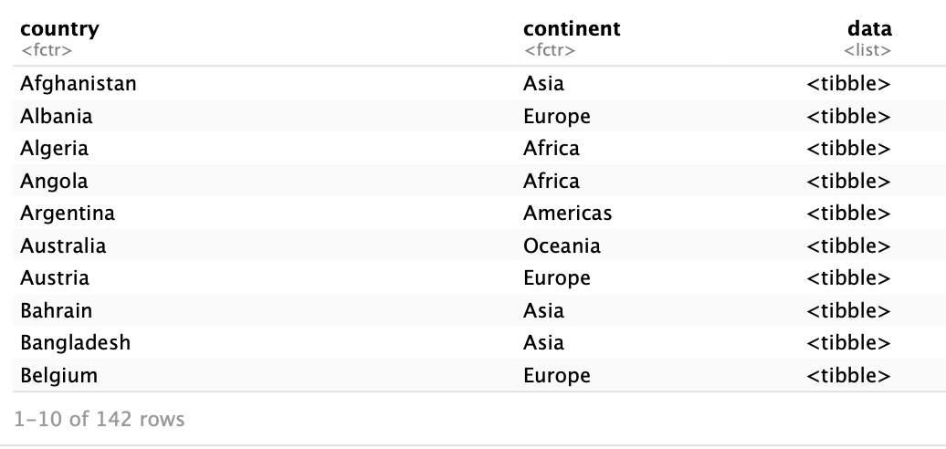

Learning the ways of the Tidyverse (force) - nest()
gapminder %>%
group_by(country, continent) %>%
nest()

Slide 19
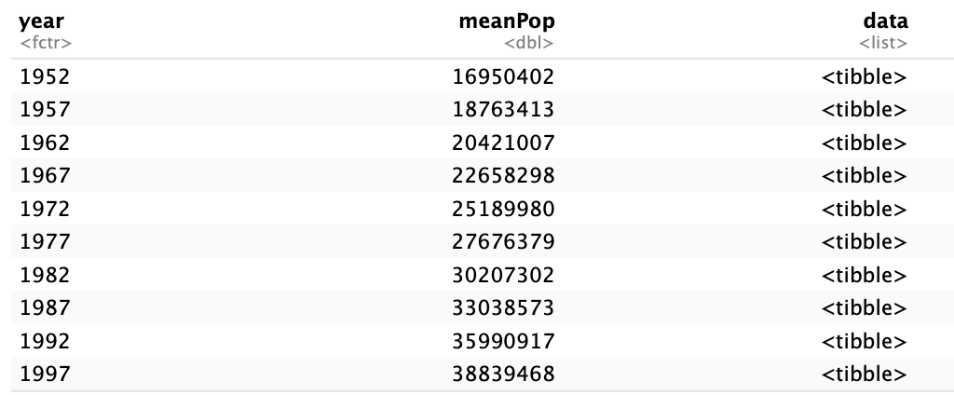
Learning the ways of the Tidyverse (force) - summarize
gapminder.byYear <- gapminder %>%
group_by(year) %>%
nest()
gapminder.byYear <- gapminder.byYear %>%
group_by(year) %>%
unnest(data) %>%
summarize(meanPop = mean(pop)) %>% # calculate the mean
inner_join(gapminder.byYear, by = “year)

Slide 20
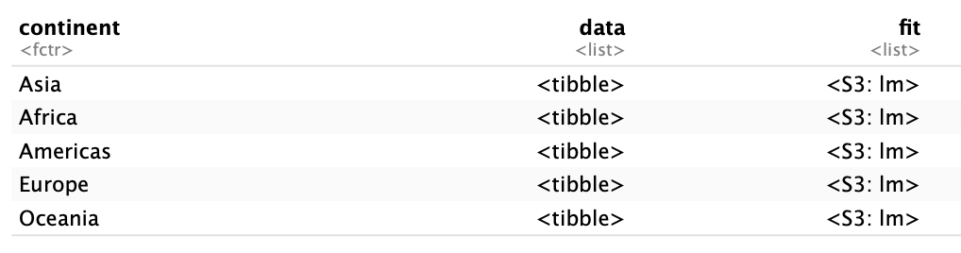
Learning the ways of the Tidyverse (force) - linear models
gapminder2.byContinent <- gapminder2 %>%
group_by(continent) %>%
nest()
gapminder2.byContinent <- gapminder2.byContinent %>%
mutate(fit = map(data, ~lm(gdpPercap ~ lifeExp + pop, data = .)))
gapminder2.byContinent

Slide 21
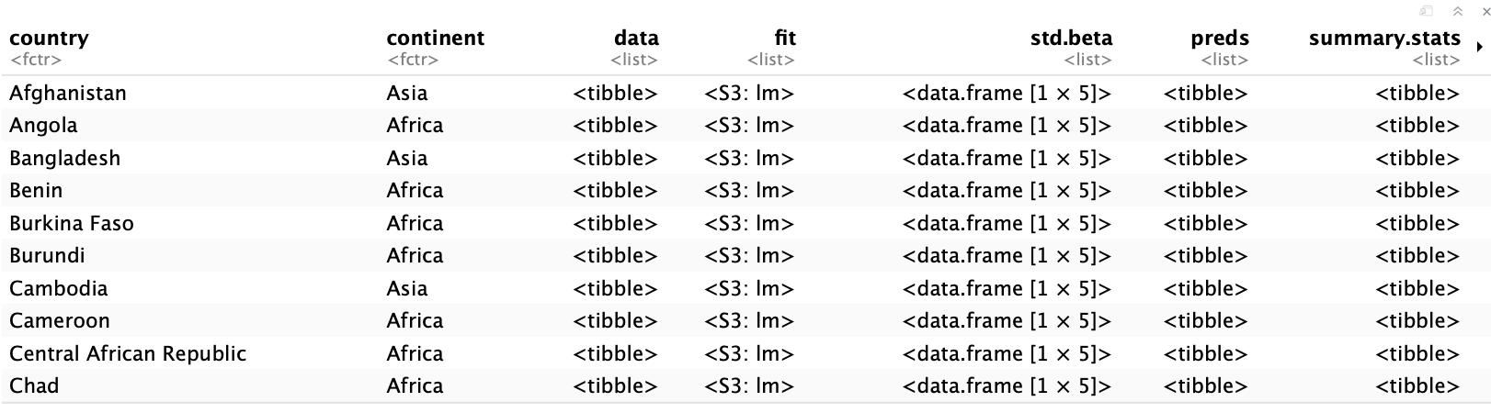
Learning the ways of the Tidyverse (force) - linear models
Tidyverse becomes hugely powerful when you use it to model your data
You can store the data that you used to perform an analysis (data), the model you ran on it (fit) the predictions of the model (preds), summary stats like AIC, BIC, R2 etc. (summary.stats)
Useful if you have multiple experiments, multiple models etc.
Pipe %>% directly from the tibble with this info into ggplot2 (more detail later)

Slide 22
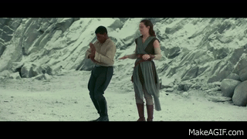
Thank you!

Slide 23


Slide 24
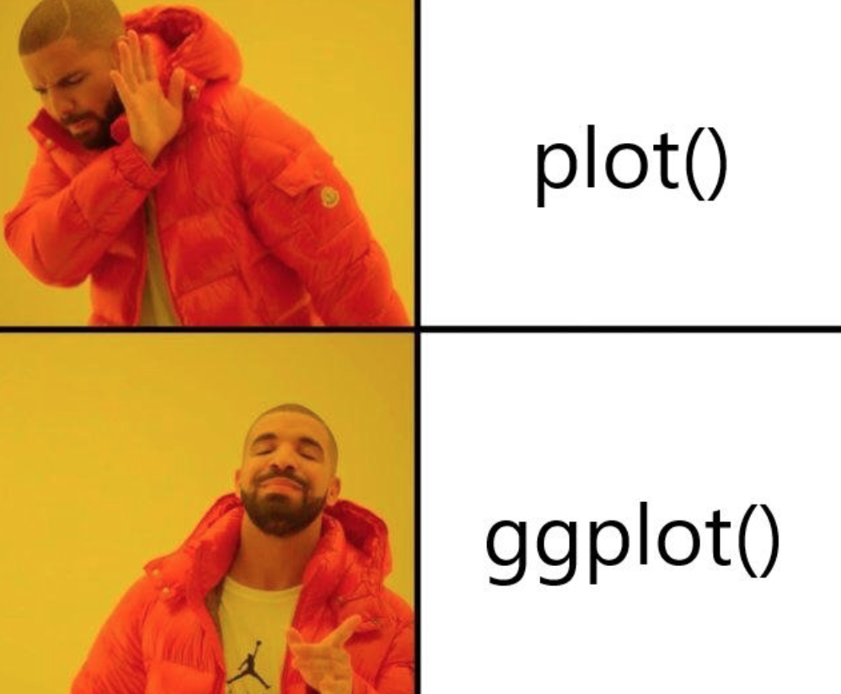
Good grammar = how to build a plot in a logical way

Slide 25
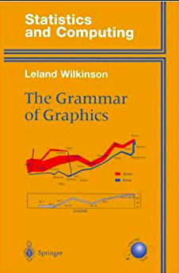
Some history
ggplot = grammar of graphics plot
Bertin (1983)
Based on a book called The Grammar of Graphics by Lenland Wilkinson (SYSTAT, SPSS, Tableau, H₂O)
“Good grammar” – what are the ingredients I need for a plot ?
Data
Axes
Stuff I do with the data (dots, lines, bars)
Inspired Hadley Wickham to develop ‘ggplot2’ package for R

Slide 26
Why ggplot2?
badfit %>%
unnest(data) %>%
ggplot(aes(x = year, y = lifeExp,
colour = country)) +
geom_line() +
xlab("Year") +
ylab("Life Expectancy in Years") +
scale_colour_manual(
name = "",
values = cbbPalette[1:6] ) +
ggtitle("Life Expectancy for \n
Worst Fitting Models Over Time")
What it needs to run:
A set of “geometries” – i.e. how we represent our data – scatter, bar, histogram etc
A set of “aesthetics” – i.e. things we do to make our data more informative – change size, shape etc. of dots, bars etc.

Slide 27
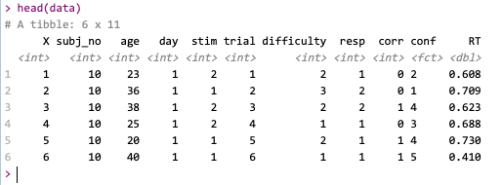
Things to be aware of (before you get your data)
Short vs long format
ggplot likes data frames tibbles

Slide 28
ggplot uses layers

Slide 29

1. The basics - layers
ggplot2 uses layers – keep adding until you like plot
data (cake)
asethetics - x, y, size, shape, colour (colours of icing, shape of cake)
geometries points, line, bar, text (layers of cake) – these also have aesthetics
statistics - regression line, binning, confidence intervals (garnish)

Slide 30
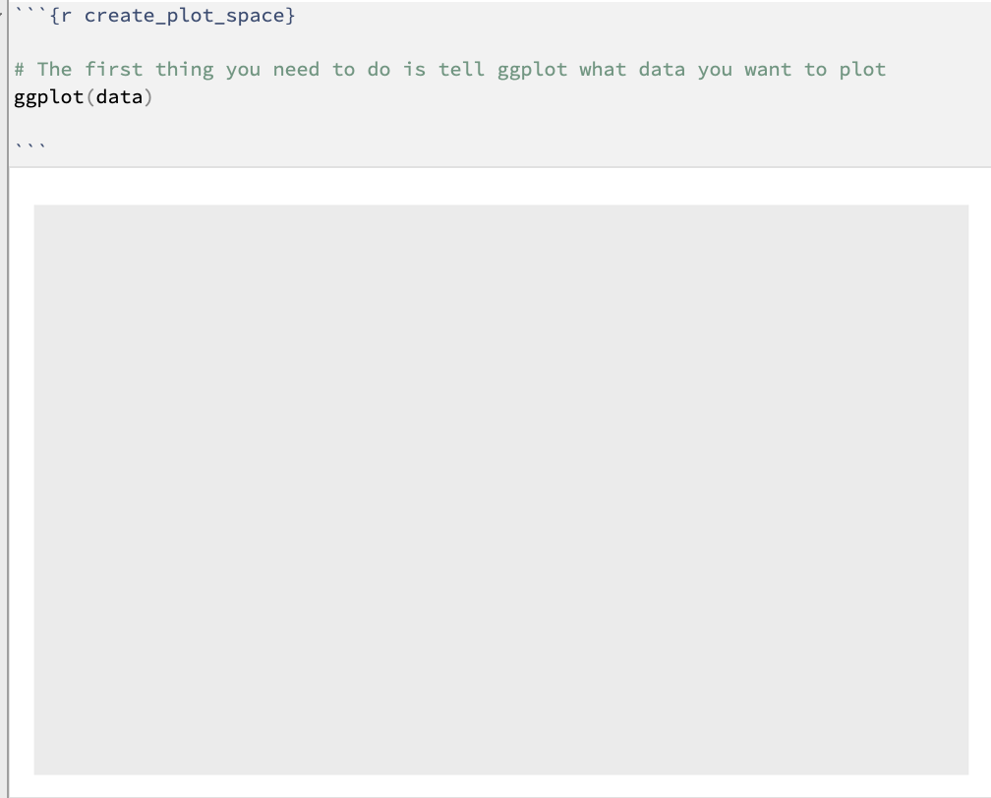
Let’s start with the ingredients for the cake (load data)
This first layer is the data
ggplot(data) tells ggplot2 you want to use the data frame called “data”
It doesn’t give you a plot (just grey box) because you haven’t said what columns you want to plot yet!
Waiting for aesthetics - shape of cake, size of cake, colour, how many layers

Slide 31
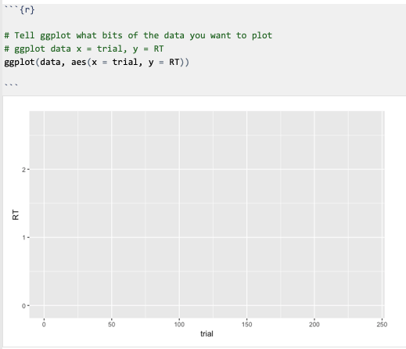

Let’s start with the data/cake (what kind of cake?)
ggplot(data, aes(x = trial, y = RT))

Slide 32
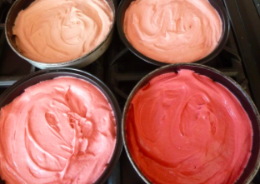
Aesthetic to data mapping (aes)
statistics - regression line, binning, confidence intervals (garnish)
asethetics - x, y, size, shape, colour (colours of icing, shape of cake)
coordinate system(base)
data (cake)

Slide 33
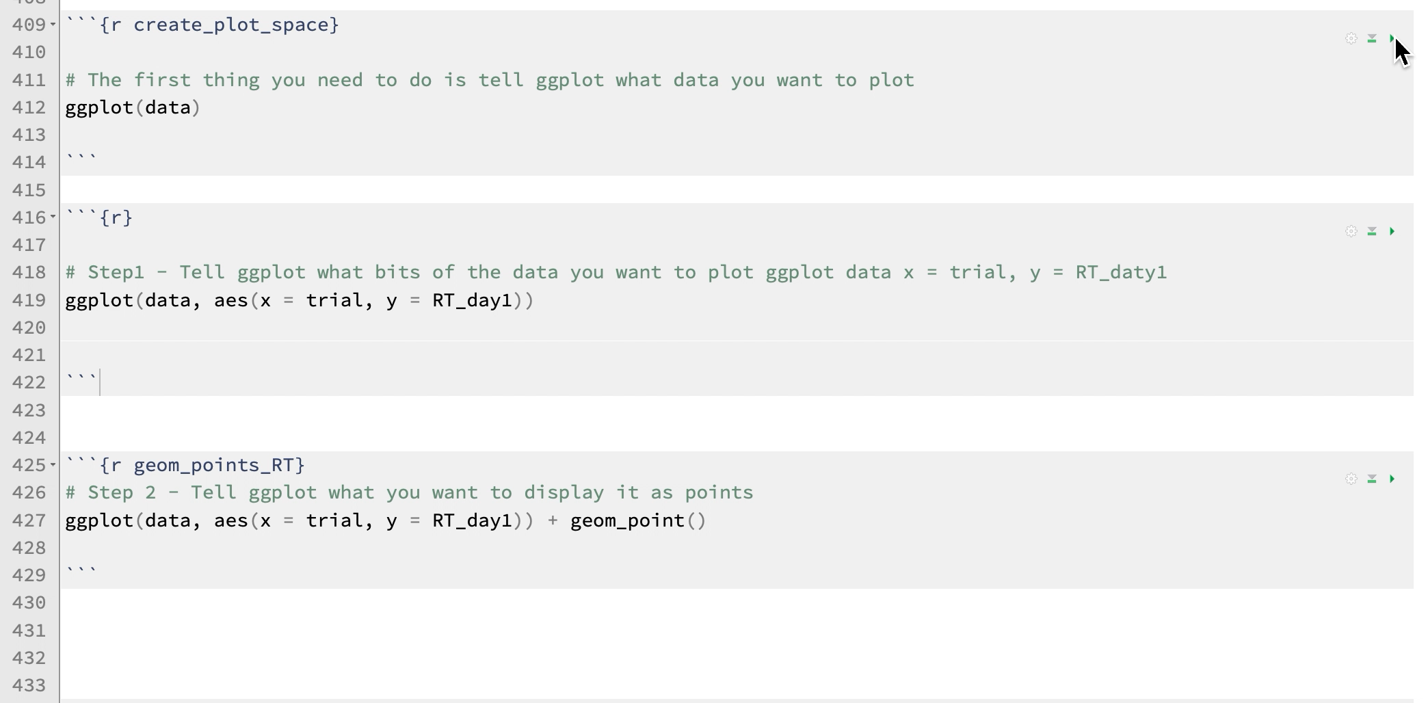
Aesthetic to data mapping (aes)

Slide 34
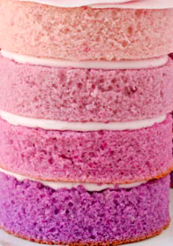
Aesthetic to data mapping (aes)
geometries points, line, bar, text (layers of cake) – these also have asthetics
asethetics - x, y, size, shape, colour (colours of icing, shape of cake)
coordinate system(base)
data (cake)

Slide 35
Aesthetic to data mapping (aes)
data$conf <- as.factor(data$conf) # convert data to a factor
ggplot(data, aes(x = trial, y = RT)) +
geom_point((aes(colour = conf)))

Slide 36
Colourblind palette

Slide 37
Barplots - geom_bar()

Slide 38
Histograms geom_histogram()
Density plots geom_density()

Slide 39
Plotting multiple subjects
ggplot(data, aes(x = trial, y = RT)) +
geom_point(aes(colour = conf)) +
facet_wrap(~subj_no)
Facet wrap is doing the work here
facet_wrap(~column)
Where subj_no is column in the data frame we are plotting

Slide 40
Plotting multiple subjects

Slide 41
Colours and legends
scale_color_manual(name = "Confidence Rating",
values = cbbPalette[1:5],
labels = c("1 = very low conf",
"2",
“3",
“4",
"5 = very high conf”)

Slide 42
Grid plotting
library(gridExtra)
violinPlot <- ggplot(data, aes(x = conf, y = RT)) + geom_violin()
jitterPlot <- ggplot(data, aes(y = RT, x = conf)) + geom_jitter()
jitterPlotfigure1 <- grid.arrange(violinPlot, jitterPlot,
ncol = 1, nrow = 2)

Slide 43
Pipe -> ggplot2
gapminder.byContinent %>%
unnest(data) %>%
ggplot(., aes(x = year, y=lifeExp,
group = country)) +
geom_line(aes(color = country)) +
facet_wrap(~continent) +
ggtitle("Life Expectancy by continent") +
theme(
legend.position = "none",
axis.text.x = element_text(size=7), # size of text on the x axis
axis.text.y = element_text(size=7), # size of text on the y axis
plot.title = element_text(hjust = 0.5, size = 13), # title settings
)

Slide 44
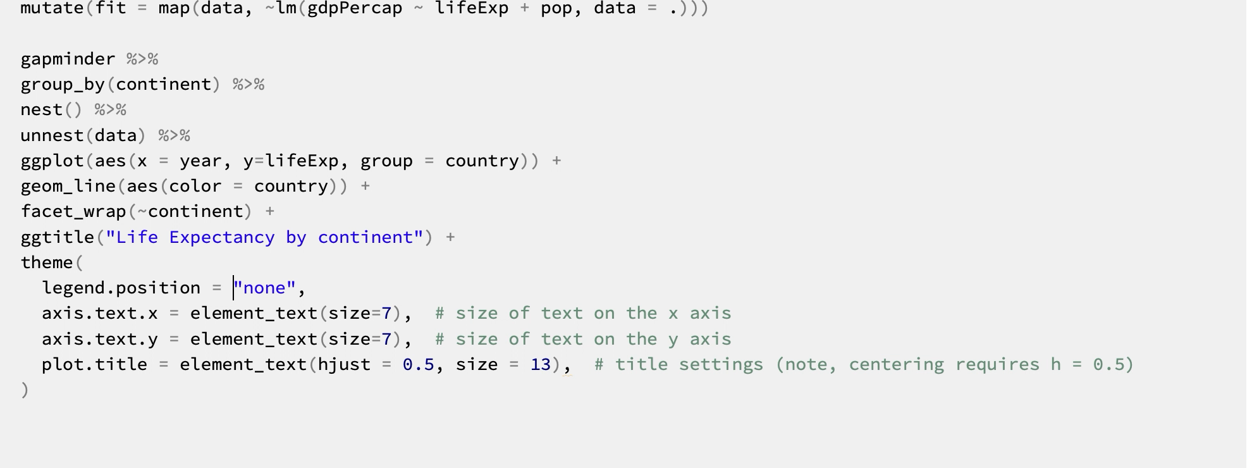
Pipe -> ggplot2 - video

Slide 45
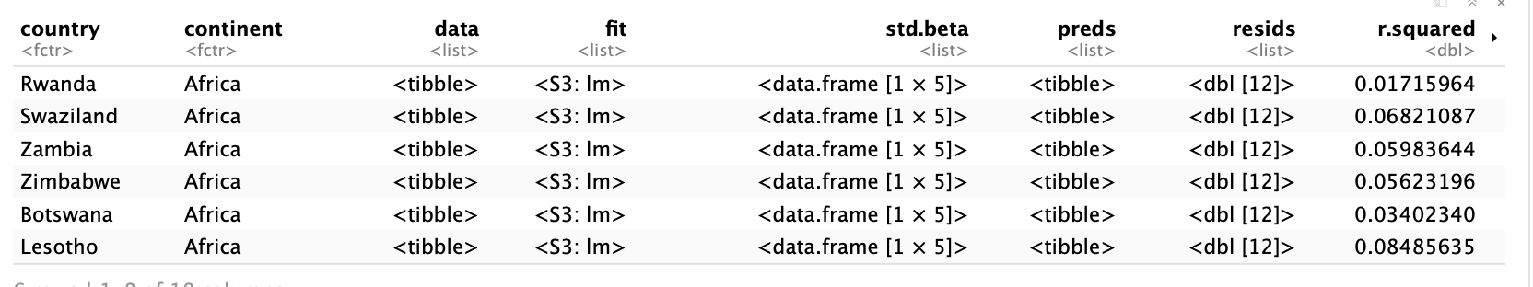
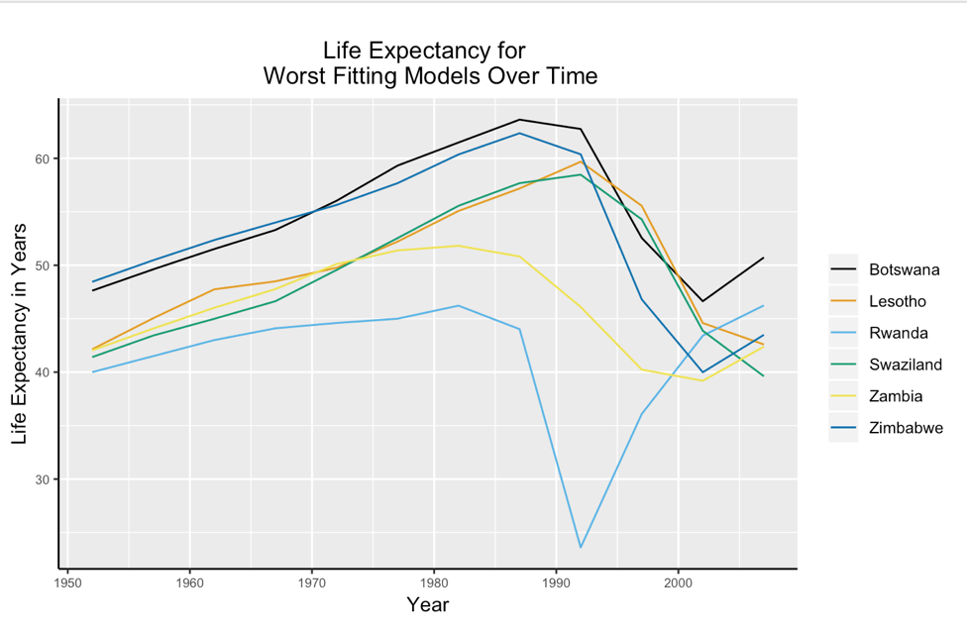
Finally….
Get all of the worst fitting models
and plot them
badfit <- gapminder2.byCountry %>%
unnest(summary.stats) %>%
filter(., r.squared < 0.25)
badfit %>%
unnest(data) %>%
ggplot(aes(x = year, y = lifeExp,
colour = country)) +
geom_line() +
xlab("Year") +
ylab("Life Expectancy in Years") +
scale_colour_manual(
name = "",
values = cbbPalette[1:6] ) +
ggtitle("Life Expectancy for \n
Worst Fitting Models Over Time")

